Slide 1


Network modelling in tuberculosis: Building the virtual patient
Michael Pitcher
PhD Student, University of St Andrews
Acid Fast Club
Summer Meeting 2019,
University of
St Andrews

Slide 2
Overview
First computational model of TB across the whole lung that incorporates environmental conditions within the organ
Understand how environmental heterogeneity impacts disease
Study the locations of bacterial proliferation during different stages of infection

Slide 3


Reducing TB treatment duration
Improve patient adherence
6 months to 4 months
How to decide which treatments to advance to phase 3 trials?
 | Type | Models | Advantages | Disadvantages
 | In vitro | Laboratory experiments | Accurately mimics human dynamics | Lack of full environment
 | In vivo | Animal models | Full organ/body environment | Don’t accurately reflect human pathophysiology
Notes:
Non-adherence
Patient – relapse
Society – AMR
Trials are expensive and lengthy
Why is modelling the whole environment important?
Prioritisation mechanism

Slide 4
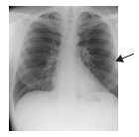
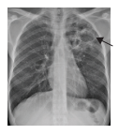
Localisations of TB
Disease stage | Localisation | Immunological events
Primary | Base of lungs | No cavitation
Latent | ? | Dormancy
Post-primary | Apex to middle of lungs | Cavitation
Primary
Post-primary
Elkington PT, Friedland JS. Permutations of time and place in tuberculosis. Lancet Infect Dis 2015; 15: 1357–60.

Slide 5
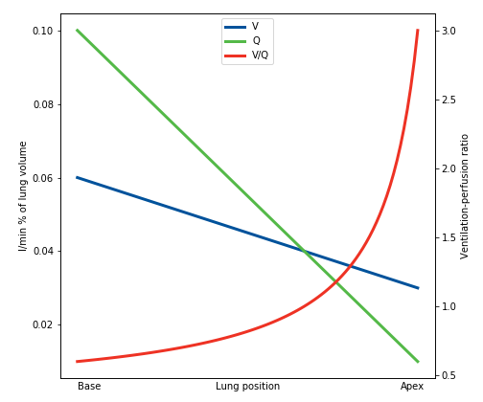
Lung heterogeneities
Environmental heterogeneities
Ventilation (V)
Perfusion (Q)
Oxygen tension (O₂)
Lymphatic drainage (G)
V,Q,G
O₂
West JB. Ventilation-Perfusion Relationships. In: Respiratory Physiology: The Essentials, 7th edn. Baltimore, Maryland, USA: Lippincott Williams & Wilkins, 2005: 55–74.
Notes:
How to include these heterogeneities within a model?

Slide 6
In silico modelling
Computational & mathematical models
Mechanistic models
(SIMULATION)
Supplementary to current models
Notes:
2. Simulations of real-world TB dynamics that occur within the host
Insight
Highlight key factors
Predictions
3. Provides us with better data and highlight avenues to research to improve our current models
TEST OUR KNOWLEDGE POSE QUESTIONS

Slide 7


WHOLE-LUNG COMPUTATIONAL MODEL OF TB
Novel in silico model of TB over whole lung:
Environmental heterogeneity
Dissemination possibilities
To better understand:
Where…
When…
How…
Why…
…of bacterial localisations during different stages of TB disease.

Slide 8
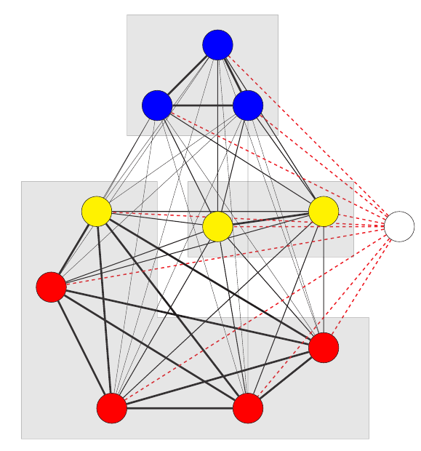
Whole-lung computational model of TB
Low perfusion,
High oxygen
Medium perfusion,
Medium oxygen
Lymphatics
High perfusion,
Low oxygen
Notes:
Shading is lobes
Each patch is a bronchopulmonary segment

Slide 9
Attributes - Environmental Conditions
Name | Symbol
Ventilation | V
Perfusion | Q
Oxygen tension | O₂
Drainage | G

Slide 10
Populations
Name | Symbol
Bacteria – extracellular, replicating | B_{ER}
Bacteria – extracellular, dormant | B_{ED}
Bacteria – intracellular, dendritic | B_{ID}
Bacteria – intracellular, macrophage | B_{IM}
Dendritic cell - immature | D_{I}
Dendritic cell - mature | D_{M}
Macrophage – resting | M_{R}
Macrophage – activated | M_{A}
Macrophage – infected | M_{I}
T-cell – naïve | T_{N}
T-cell activated | T_{A}
Notes:
We only model 1 type of (generalised) t-cell for simplicity/parsimony
DONT USE THE WORD ‘COMPARTMENT’ HERE - ”members” or “species” or something like that
Simplified the immune system because it is computationally intense

Slide 11
Population
 | #
B_{ER} | ₁₀₀
B_{ED} | ₈₀
B_{ID} | ₁₀₅₆
B_{IM} | ₁₀₅
D_{I} | …
D_{M}
M_{R}
M_{A}
M_{I}
T_{N}
T_{A}
Environmental conditions
PATCH
 | #
V | _{0.1}
Q | _{0.3}
O₂ | _{3.0}
G | _{0.4}

Slide 12
Events
Populations change on each event
> 40 events
Recruitment
Replication
State changes
Cell infection
Environment dependent events
Cell recruitment – PERFUSION
Bacterial state change – OXYGEN
Dissemination – DRAINAGE / PERFUSION
Notes:
Dissemination links to next slide

Slide 13
Dissemination
Immune cells migrate to lymphatics
Also carry bacteria
Bacteria in lymphatics re-enter lung
Based on perfusion
Bacteria disseminate within lung
More likely to disseminate to patch in same lobe

Slide 14
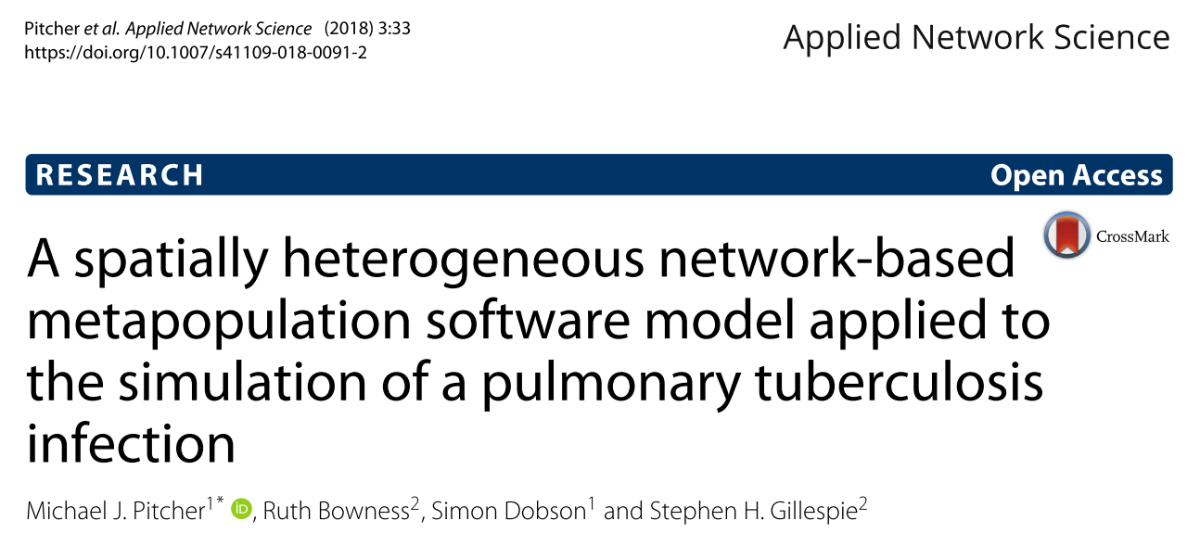
RESULTS

Slide 15
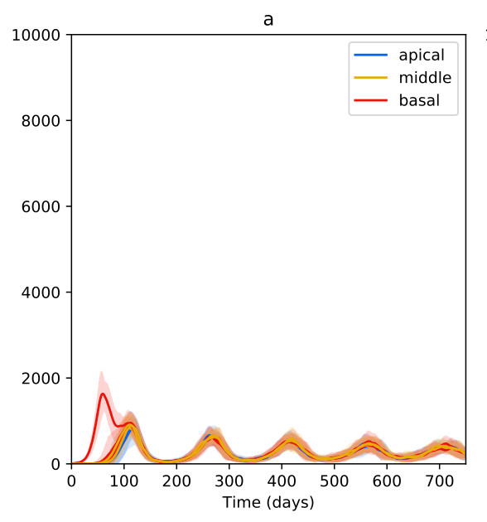
Effects of heterogeneity in environment
Bacteria
No heterogeneity

Slide 16
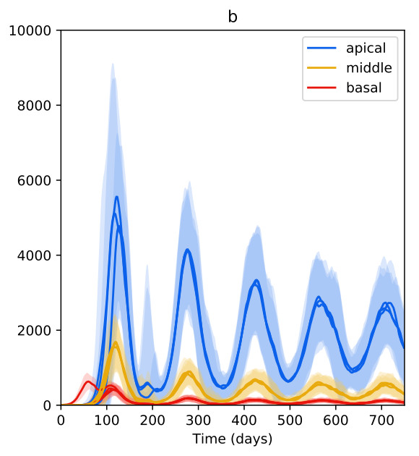
Effects of heterogeneity in environment
Bacteria
Heterogeneous

Slide 17
Effects of heterogeneity in environment
Bacteria
No heterogeneity
Heterogeneous
Notes:
Waves of infection which match
With heterogeneity, inevitable that bacteria will proliferate at apex

Slide 18
Conclusions 1
Environmentally heterogeneity → Different bacterial loads
Dissemination routes are less important
Where is important, how is not
So future models should consider whole lung scales and environmental impacts

Slide 19
Primary
Latency
Postprimary
TB lifecycle
Bacterial levels kept under control
Immune system weakens
Bacterial proliferation
Cavities form
Infection starts in lower regions
Dissemination to lymphatics and other regions

Slide 20
Model Developments
Granular network
More, smaller patches
Weakening immune system
T-cell deficiency
Cavitation
Caseum

Slide 21
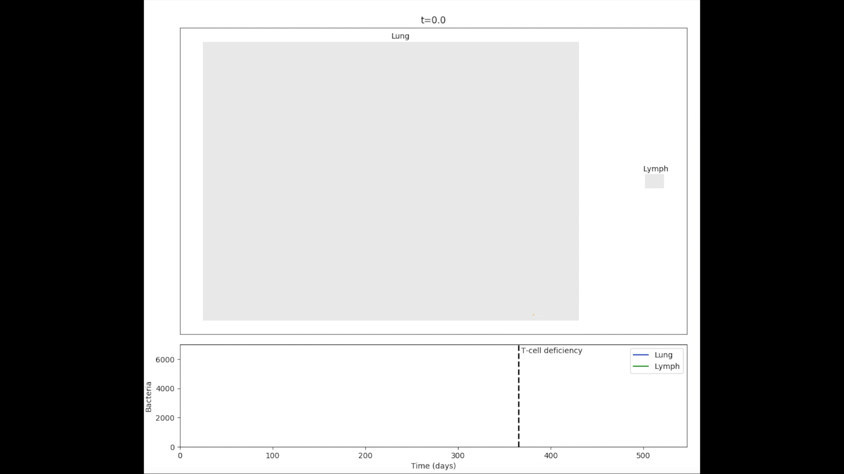
Results
Notes:
Lower regions do get seeded – but the adaptive immune response there wipes out bacteria quickly
So the upper to middle region is the hot spot:
PERFUSION – perfusion is low enough that immune response is not sufficient to quell bacteria
But not so low that bacteria can’t get there (the absolute apex would be ideal for bacteria, but impossible to get there through blood)
Also oxygen availability towards apex

Slide 22
Conclusions 2
In silico model of whole-lung TB lifecycle:
Primary
Latency
Post-primary
Demonstrated that environmental heterogeneity leads to cavity formation at the apex of the lung

Slide 23



Future Work 2
Between-person
heterogeneity
Pharmacology
Virtual clinical
trial
Notes:
Differences:
Lung disease
Immunity
Lung sizes
How env heterogen affects PK/PD
PK (perfusion affects drug concentrations)
PD (drugs work in different env, e.g. pyrazinamide in pH)
VCT
Run novel regimens over synthetic populations
Make predictions on likely efficacy
Prioritise those that perform well

Slide 24

Q&A
My details:
Michael J. Pitcher
Email: mjp22@st-andrews.ac.uk
Twitter: @michaeljpitcher
PhD Student 2015-19,
University of St Andrews
Acknowledgments:
Prof Stephen Gillespie
Prof Simon Dobson
Dr Ruth Bowness
Dr Derek Sloan
Dr Tom Kelsey
Prof Mark Chaplain
Dr Raluca Eftimie (University of Dundee)
Infection & Global Health Division
Systems Research Group
Health Informatics Group
Funded by:

